Slide 1
Histogram
LAB

Slide 2
Histogram Adjustment: Adapt to noise and sensor inaccuracies
Android sensors are subject to noise and inaccuracies
Impact: same observation in different session can produce different sensor readings

Slide 3
Histogram Adjustment: Adapt to noise and sensor inaccuracies
Example: at the first reading, the sensor will produce output 39
At the second reading (at the same observation place), the sensor can produce other value, such as 37, 38, 39, 40, 41, 42, etc.
First reading:
39
Second reading:
37
38
39
40
41
42

Slide 4
LAB:
Supposed we have this first batch of sensor readings like this:
[34; 45; 67; 37; 43; 42; 56; 55; 48; 49; 50; 33; 29; 25; 65; 59; 47; 41; 39; 20]
At the second reading, the sensors are affected with noise and shifted the readings 2 points to the right.
It will affect the histogram produced
shiftedData = normalData + 2;

Slide 5
Question to answer:
We will apply histogram adjustment function to the normal data and shifted data (caused by noise)
Does the histogram function will make our system more noise tolerant?
We will use distance function (pdist) to calculate the distance between normal and shifted data
Compare pdist function applied to normal and shifted data, before and after the adjustment

Slide 6
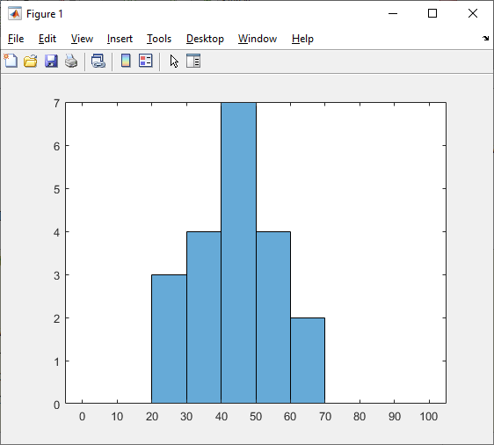
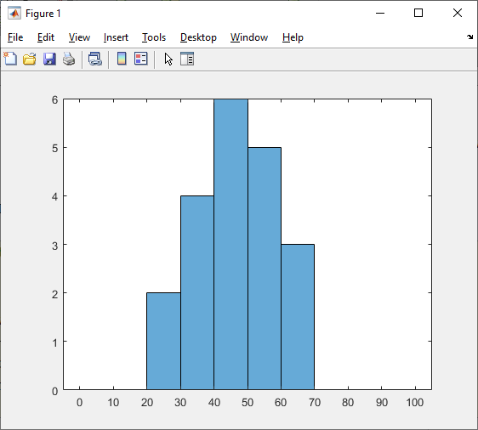
Original Histogram Comparison
Normal Data
Shifted Data

Slide 7
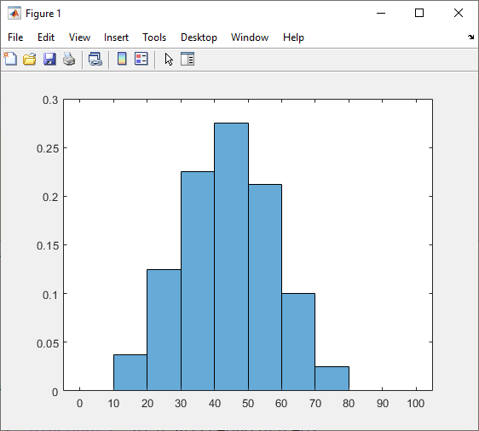
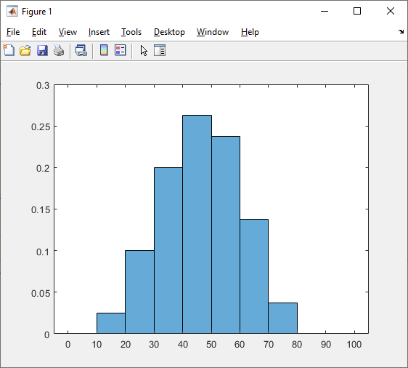
Adjusted Histogram Comparison
Normal Data
Shifted Data

Slide 8
LAB objectives:
The difference between two original histogram and adjusted histogram comparison can be measured by eye. But, it will be better if we measure it by precise metrics: Euclidean distance, KLD, EMD.
Find the distance between normal data and shifted data at both original and adjusted histogram.

Slide 9
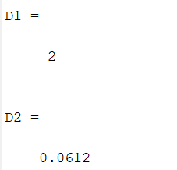
Distance between histogram
D1 = distance between two original histogram
D2 = distance between two adjusted histogram

Slide 10
Histogram Adjustment: Adapt to noise and sensor inaccuracies
The histogram adjustment method will minimize the distance between normal data and shifted data. What is the prove?

Slide 11
MATLAB Setup:
We will use MATLAB online for running the lab
Refer here for instructions on how to register MathWorks account
https://software.ncu.edu.tw/download/application
(login using your NCU Portal student number and password)
After successfully creating your account using school email address, login to MATLAB online here
https://www.mathworks.com/products/matlab-online.html

Slide 12
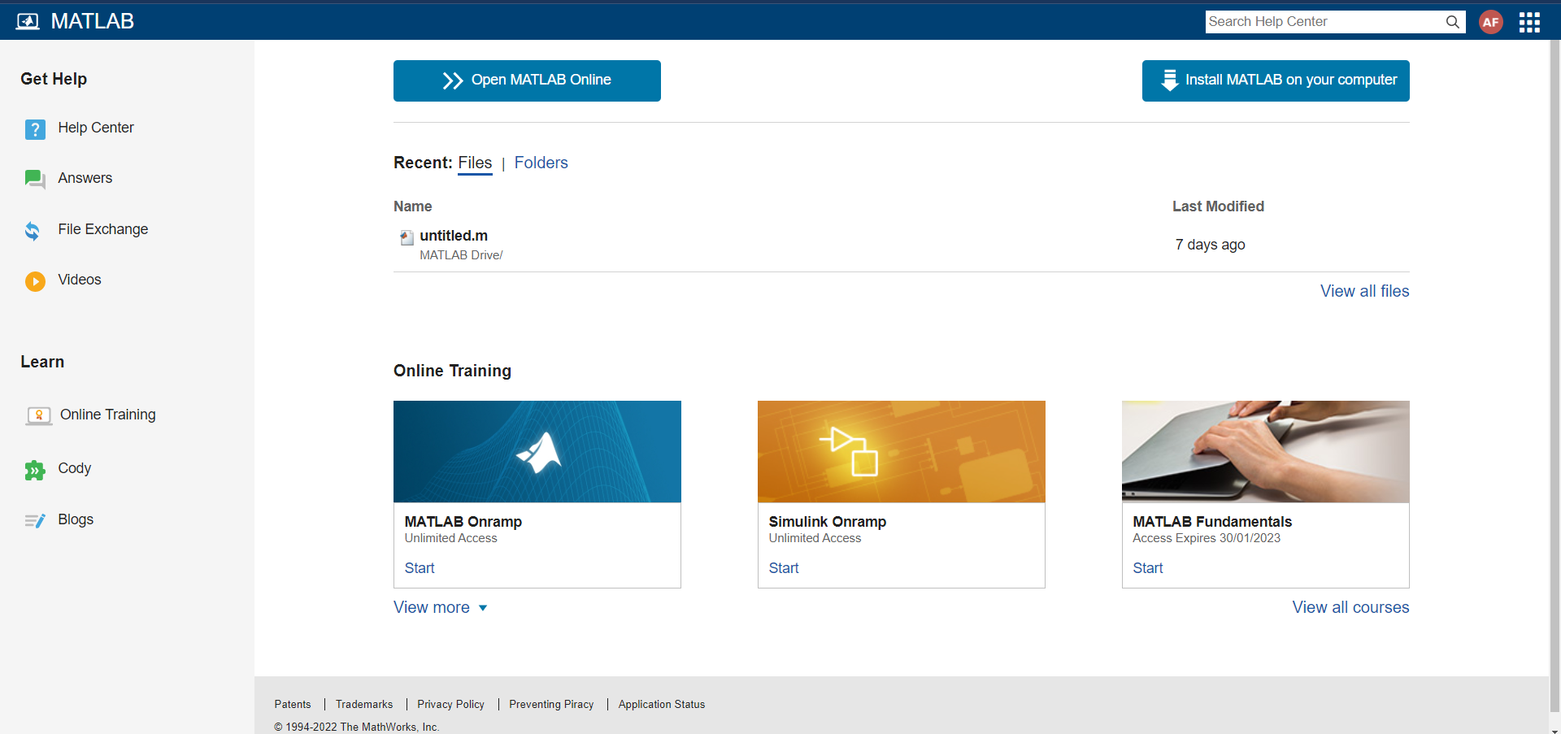
MATLAB Setup:
After logged in, click “Open MATLAB Online”

Slide 13
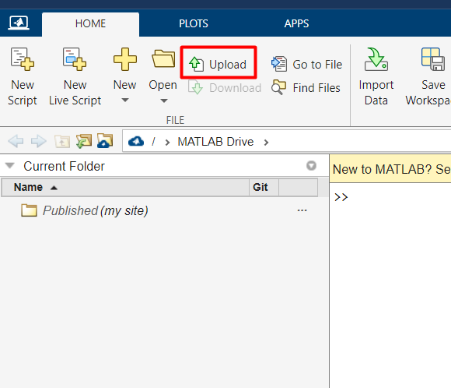
Run The Code:
Click “Upload”, and find your downloaded histogramLab.m

Slide 14
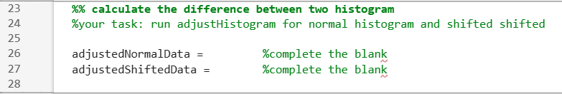
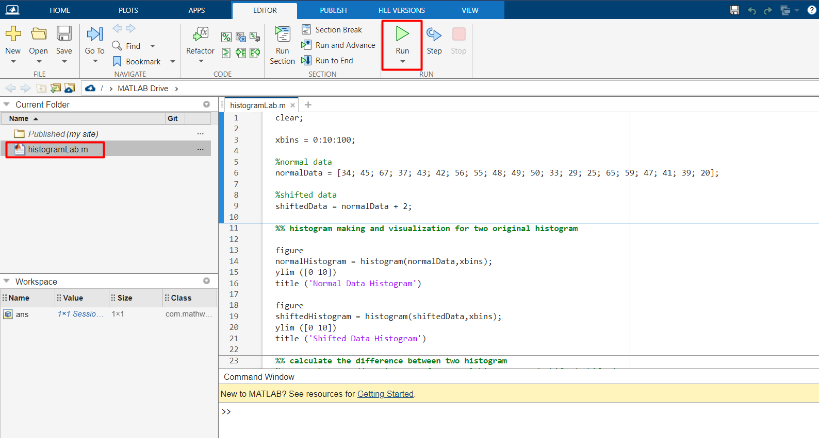
Run The Code:
Double click on histogramLab.m, edit as necessary, then click “Run”

Slide 15
Report
Group Task(Report should be in English)
Content:
Screenshot of original histogram (normal and shifted)
Screenshot of adjusted histogram (normal and shifted)
Distance calculation (original)
Distance calculation (adjusted)
Your analysis
What makes the difference?
Why histogram adjustment works?

